Slide 1
8. Comparing Populations

Slide 2
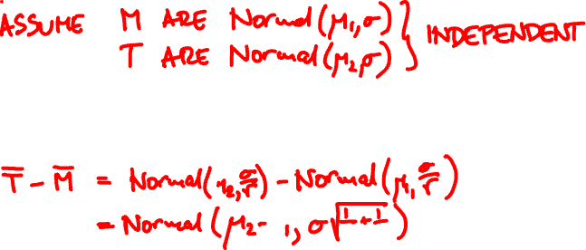
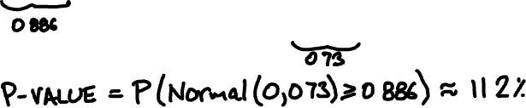


A thermometer with σ = 1℃ reports readings
M: 23.5 23.3 21.3 22.1 23.7
T: 22.8 24.5 23.7
Has the temperature increased?

Slide 3
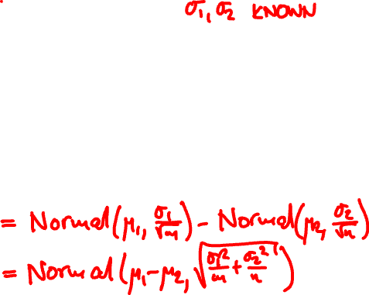
Comparing normal means
X₁, …, X_{m} Normal(μ₁, σ₁)
independent
Y₁, …, Y_{n} Normal(μ₂, σ₂)
Null hypothesis: μ₁ = μ₂
X – Y

Slide 4
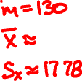
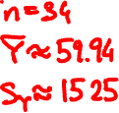
80 74 70 77 70 73 74 67 66 76
69 66 62 66 64 51 48 64 64 54
47 71 63 57 56 54 59 57 41 52
54 35 38 47 33 48 48 40 44 59
32 48 57 48 38 51 56 53 56 47
44 39 52 40 43 43 53 39 33 41
29 39 40 44 45 26 34 34 35
44 33 37 37 15 44 37 34 24
24 23 28 35 36 36 30 31 30 36
29 37 23 26 26 18 27 38 38 27
36 28 26 24 16 34 27 20 28 16
9 16 25 16 14 10 16 34 20 6
22 22 6 30 26 12 4 13 13 15
80 78 80 70
77 70 79 69
72 66 64 68
67 60 67 56
55 70 53 56
70 61 60 59
58 56 49 55
50 49 36 44
21 13
ENGG scores
ESTR scores

Slide 5
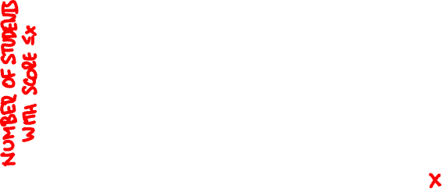
ENGG
ESTR

Slide 6
ENGG
ESTR

Slide 7



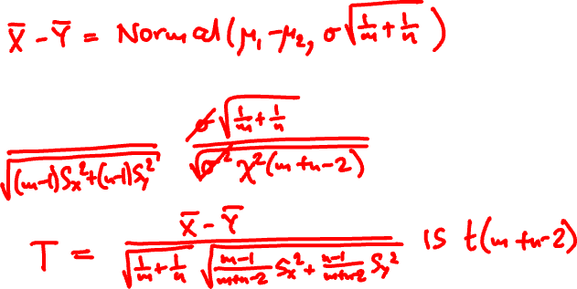
Normal means, unknown variance
X₁, …, X_{m} are Normal(μ₁, σ)
independent
Y₁, …, Y_{n} are Normal(μ₂, σ)

Slide 8
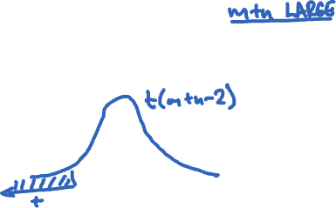


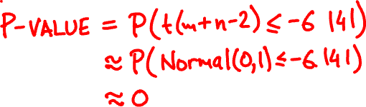


What is the p-value for hypothesis
“ESTR students do better on final”

Slide 9
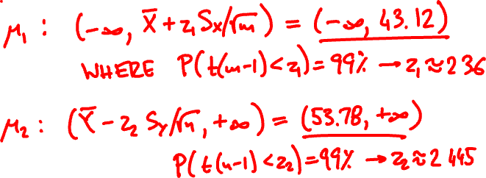


What are the 99%-confidence bounds for μ₁, μ₂?

Slide 10


Observational vs. Randomized
Observational study
No control over differences in population
Are ESTR students better prepared? More
skilled? Better at taking tests?
Randomized controlled experiment
Assign subjects to treatment randomly

Slide 11
final (out of 70)
midterm (out of 60)

Slide 12
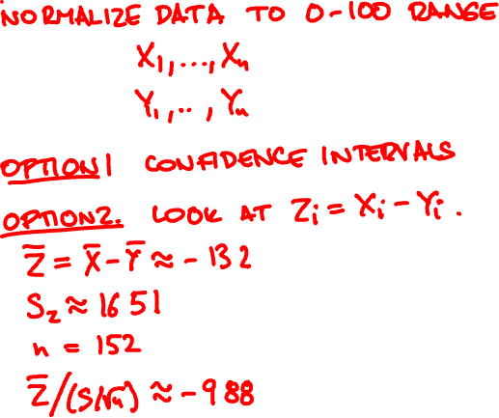
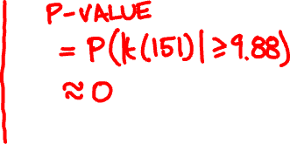


Is there a difference in performance between midterm and final exams?

Slide 13
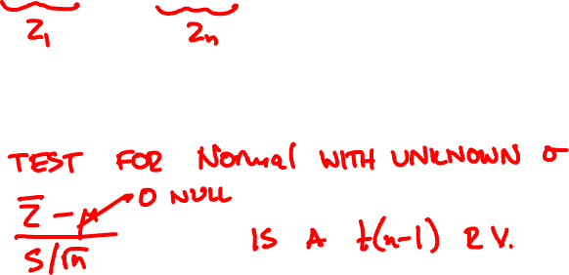
Paired t-test
X₁ – Y₁, …, X_{n} – Y_{n} independent Normal(μ, σ)
Null hypothesis: μ = 0

Slide 14
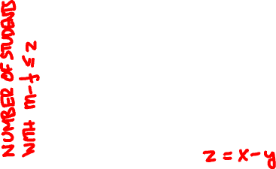

Slide 15
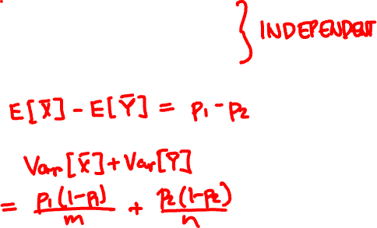
Comparing population proportions
X₁, …, X_{m} independent Indicator(p₁)
Y₁, …, Y_{n} independent Indicator(p₂)
E[X – Y] =
Var[X – Y] =

Slide 16
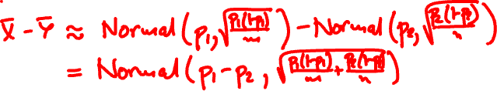
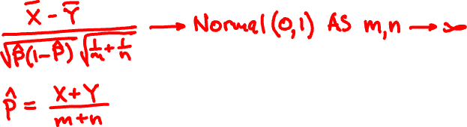
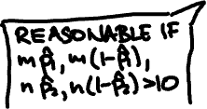
Comparing population proportions
Null hypothesis: p₁ = p₂

Slide 17

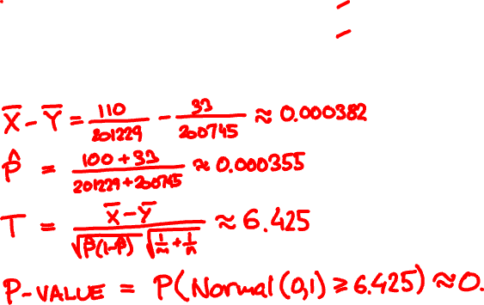

In 1953 the Salk polio vaccine was tested in a randomized controlled experiment
subjects cases
placebo 201,229 110
vaccine 200,745 33
What is the p-value?

Slide 18
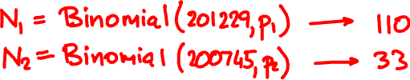

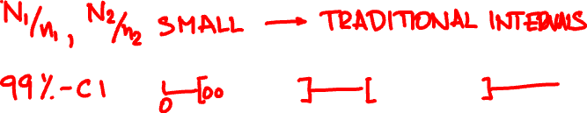

What are the 99% confidence intervals for p₁, p₂?

Slide 19
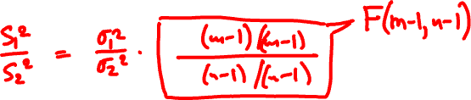


Comparing normal variances
X₁, …, X_{m} independent Normal(μ₁, σ₁)
Y₁, …, Y_{n} independent Normal(μ₂, σ₂)
Null hypothesis: σ₁ = σ₂

Slide 20
The F(m, n) random variable
χ²(m)/m
F(m, n) =
χ²(n)/n
m = n = 29
m = n = 99

Slide 21

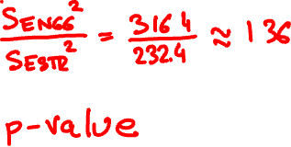

The sample variances for ENGG and ESTR finals are:
subjects S²
ENGG 130 316.4
ESTR 34 232.4
What is the p-value for the hypothesis ESTR has lower variance in scores?

